Slide 1


COPILOT Usage and Key Agents
April 13, 2025

Slide 2
Microsoft COPILOT Summary
Product Component | Capabilities | Subscription
Foundational Capability
Copilot in Word | Enhances writing efficiency and creativity by helping users create, summarize, comprehend, refine, and elevate documents. | Enabled
Copilot in Excel | Unlocks Excel's full capabilities for data analysis, visualization, and insights extraction. | Enabled
Copilot in PowerPoint | Assists in creating compelling presentations by transforming text into slides, summarizing content, and organizing presentations. | Enabled
Copilot in Outlook | Helps manage emails by drafting, summarizing, and facilitating impactful communication. | Enabled
Copilot in Teams | Enhances collaboration by recapping conversations, organizing key discussion points, and summarizing meetings. | Enabled
Copilot Chat | Web-Grounded Chat: Market Research: Conducts research and gathers insights from the web. Document Preparation: Helps write strategy documents and prepare for meetings | Enabled
Agents (by Microsoft )
Agents in Copilot Chat (Ready To Use) By Microsoft | Writing Coach , Idea Coach , Prompt Coach , Career Coach , Learning Coach , Visual Creator | Available Part of COPILOT License /Need to activate
Agents in Copilot Chat (Need Development) | Onboarding Buddy, Resume Reviewer , Contract/ Legal Review , Research Assistant , Policy Search | Need Development
Data Fabric
COPILOT in Data FABRIC | Microsoft Copilot in Data Fabric is an AI-enhanced toolset designed to streamline data integration and transformation tasks. It supports both citizen and professional data wranglers by providing intelligent code generation and explanations | Need Separate Subscription
Enabled for the MEC Core Users (16)

Slide 3
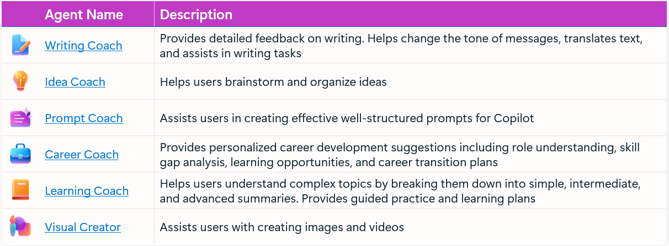
Agent in Copilot Chat – Ready to Use
Review and Enable for users

Slide 4
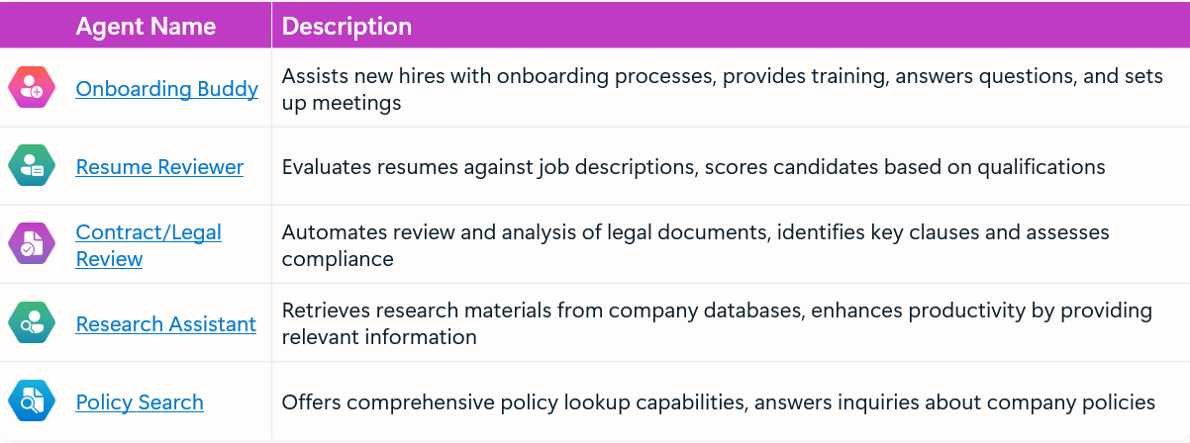
Agent can be Created in Copilot Chat
Using AI Foundry is More Cost Effective

Slide 5
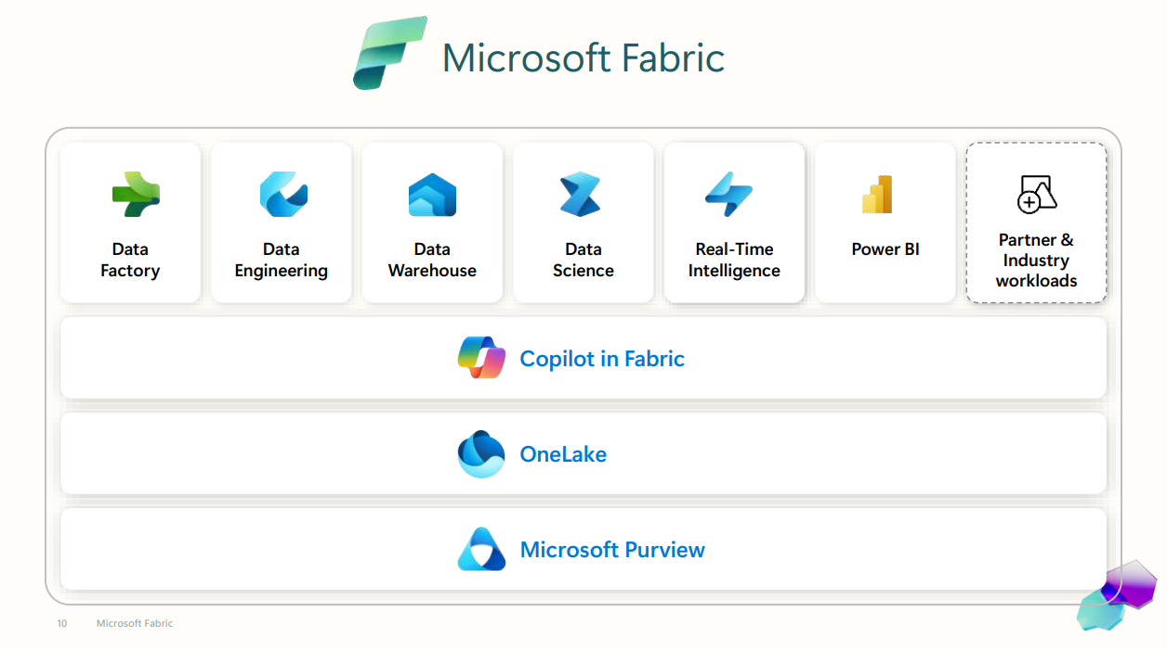
COPILOT in Data Analytics

